Slide 1

WCTC Travel Portal
Hailey Kotvis, Jessie Schlitt, Kyle Duehr, Nick Flatow
Notes:
JESSIE
Hi, my name is ______, I have an internship at ______ (or am looking)
Talk about main changes
Main focus: was flow improvements of the web application for students
We interviewed students to see pain points

Slide 2
High-Level Overview
Administrator
Coordinator
Student
Create roles, change passwords, edit user roles
Create a trip, confirm form/payment submission, check student status
Sign up for trips, print forms, update profile information, and check trip status
Notes:
JESSIE
What is it?
Coordinator create trip
Student can sign up for trip
Keep both Coordinator and Student on the same page for completion status of forms and payment

Slide 3

Our Focus
To give student users a complete experience
Adding necessary components to coordinator/student sides
Eliminating unnecessary screens and clicks
Making the application as straightforward as possible
Notes:
Kyle
Now you may be asking… how did you accomplish this?
Keywords - Coordinator/Student pages, Streamlined, Accessibility

Slide 4

Student/Coordinator Trials
Notes:
Kyle
-Overview-
What we did was --- Interviews.

Slide 5

Student Pain Points
Trip Application Process Feedback
Found the initial version of the software unintuitive and confusing
Unsure of what was expected of them when filling out forms and creating a profile
Using their feedback we developed a better flow for the system
Notes:
Kyle
Keywords - Intuitive, User Evaluation , to-do list

Slide 6
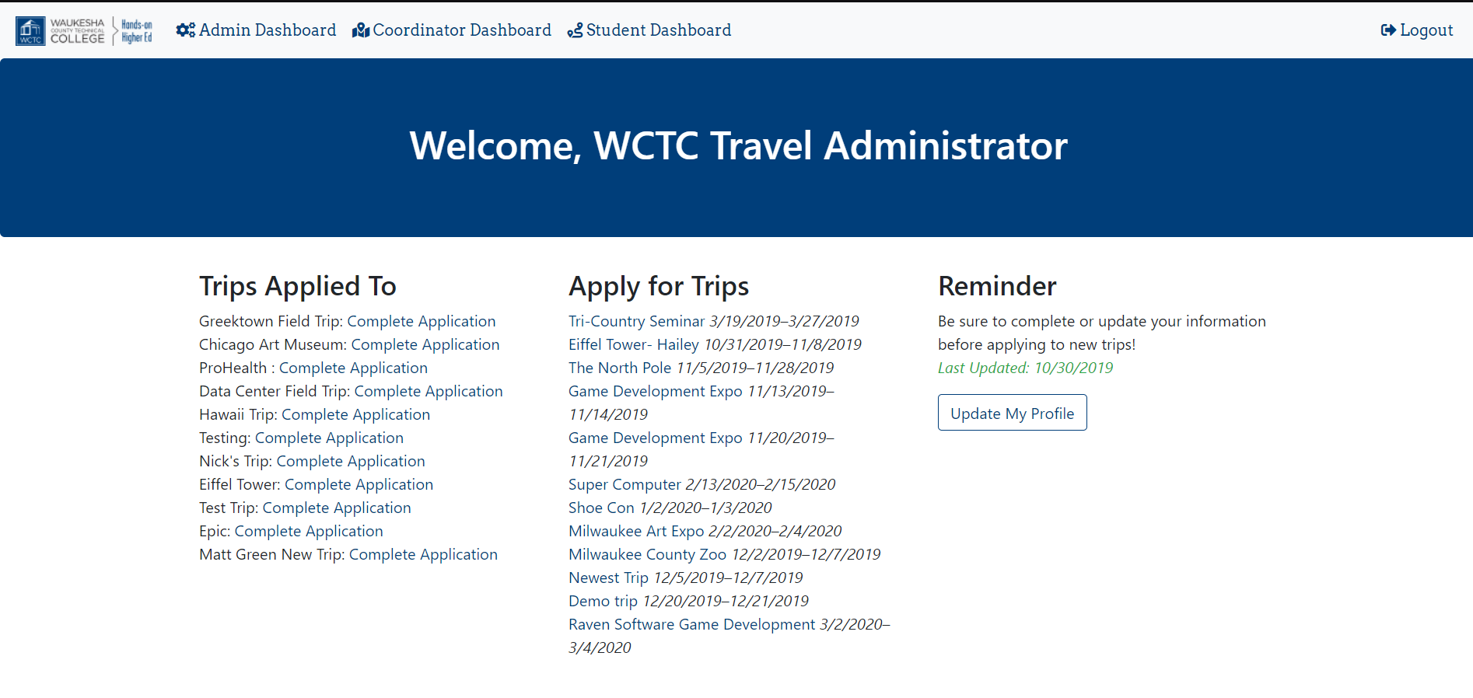
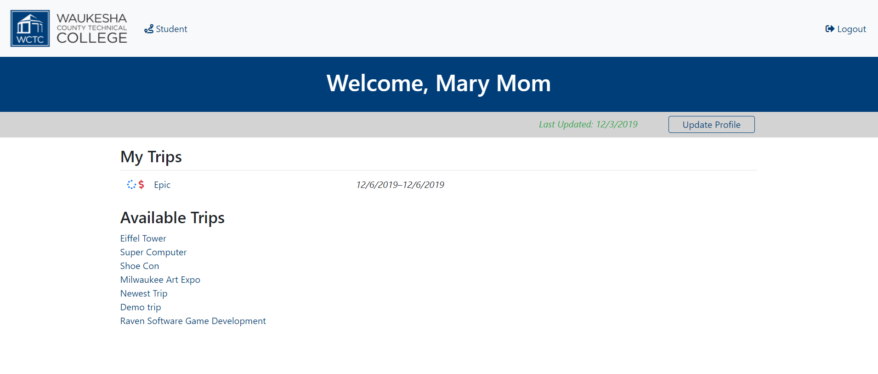
BEFORE
Student Comparison
AFTER

Slide 7
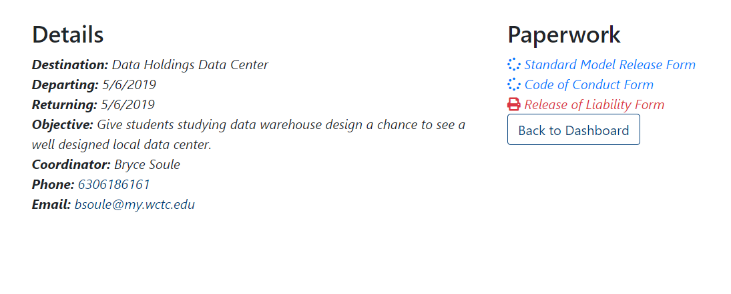
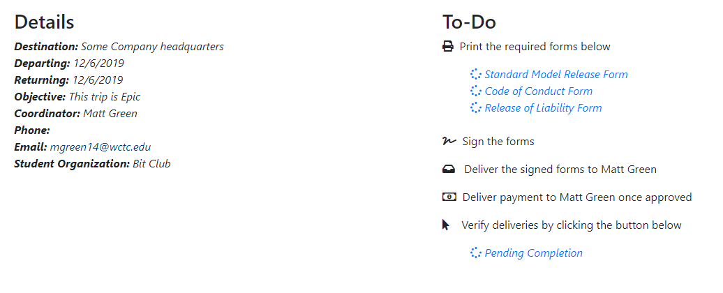
BEFORE
Student Trip Detail Comparison
AFTER

Slide 8

Coordinator Pain Points
Trip Coordinator Process Feedback
Wording
Icon tooltips
Subnavigation
Other coordinator trips
Undo
Deny student
Notes:
Hailey
Wording (deny/reject form and upcoming/my trips)
Tooltips for icons so user can know what it means
Were showing other coordinator trips, not needed and distracting...only need their trips
Undo ( form approval / rejection) because it could be a mistake
Sub navigation menu
Deny a student

Slide 9
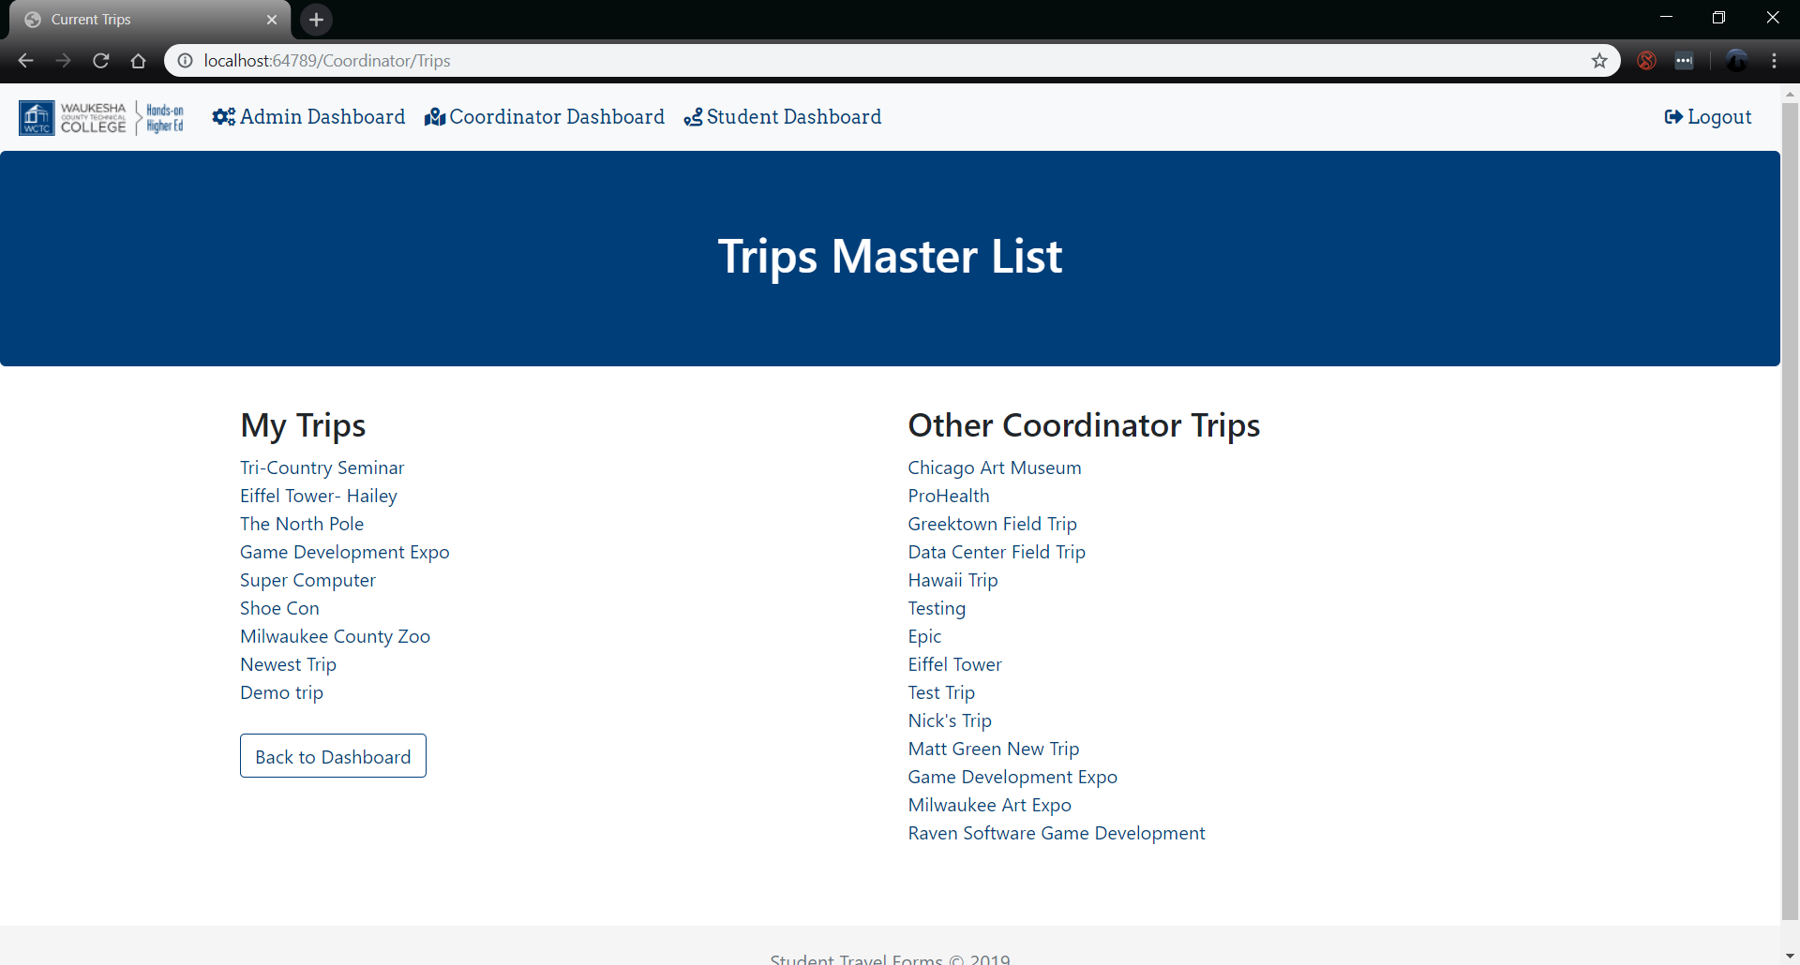
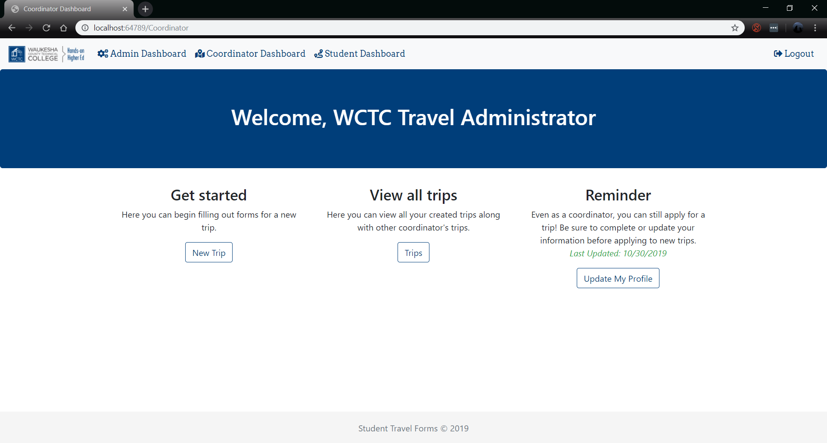
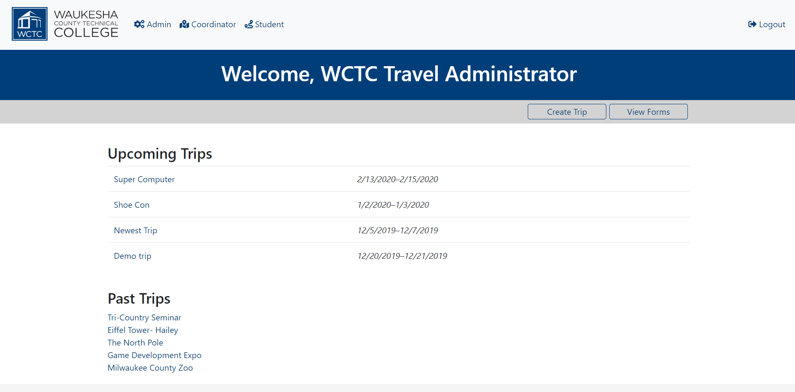
BEFORE
Coordinator Comparison
AFTER
Notes:
Jessie
Hailey -Screenshots

Slide 10
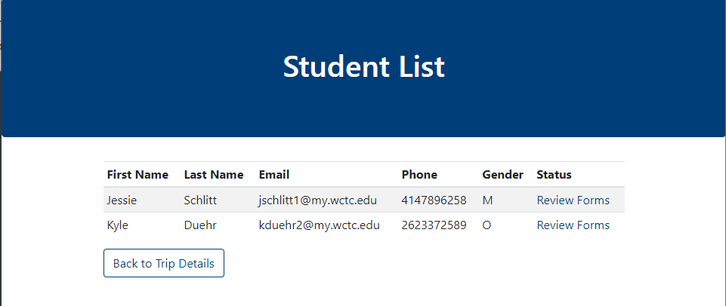
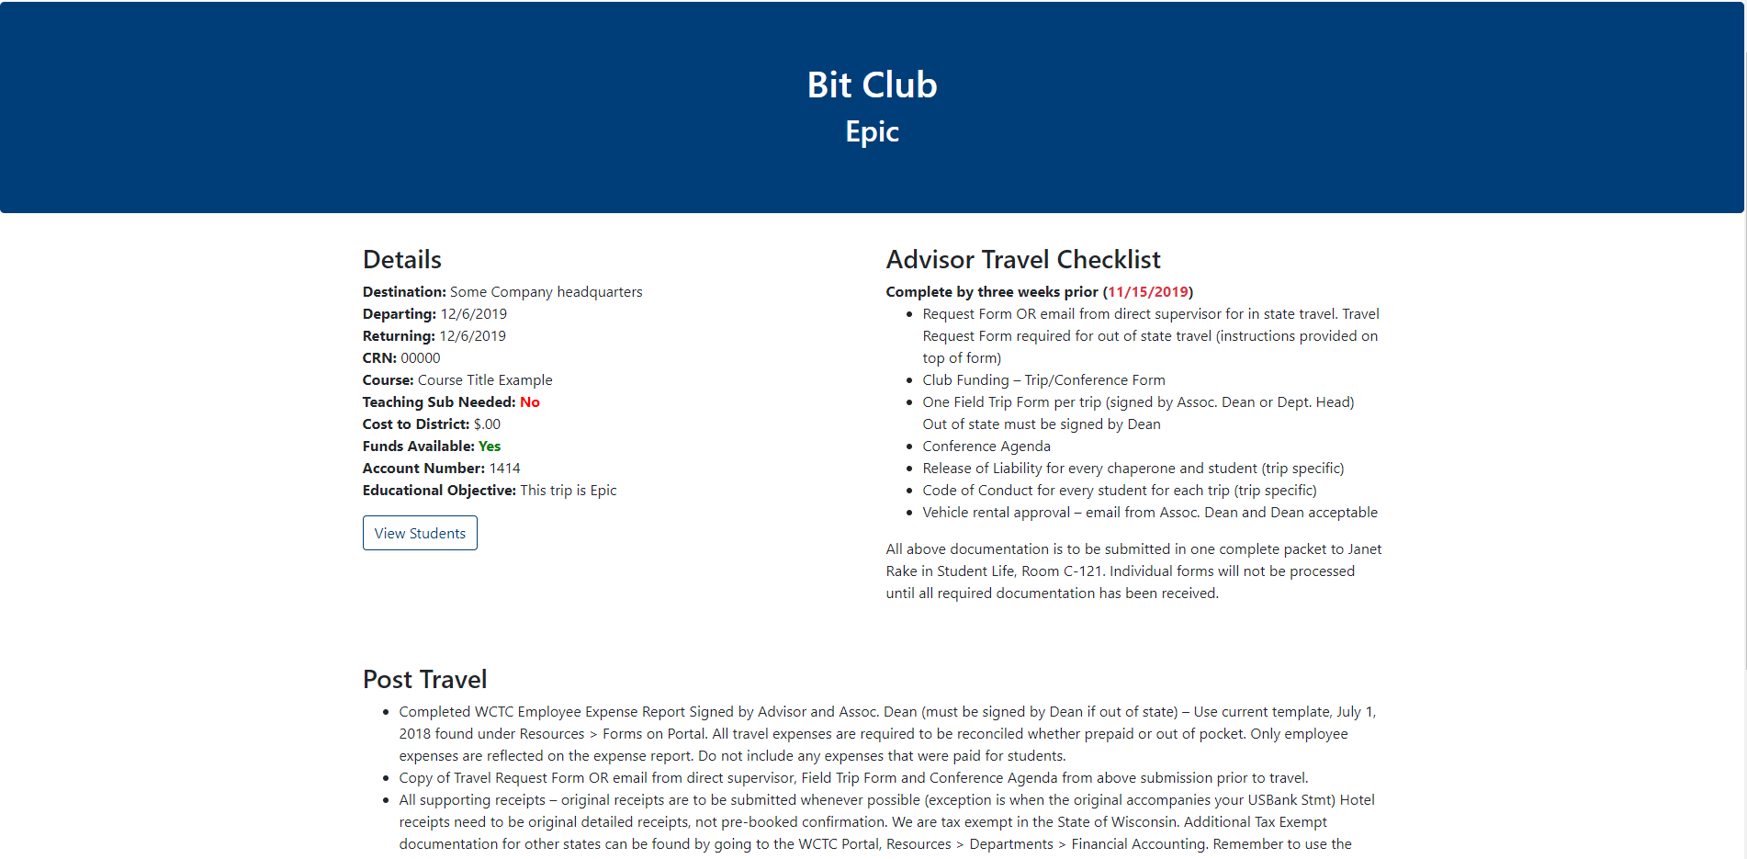
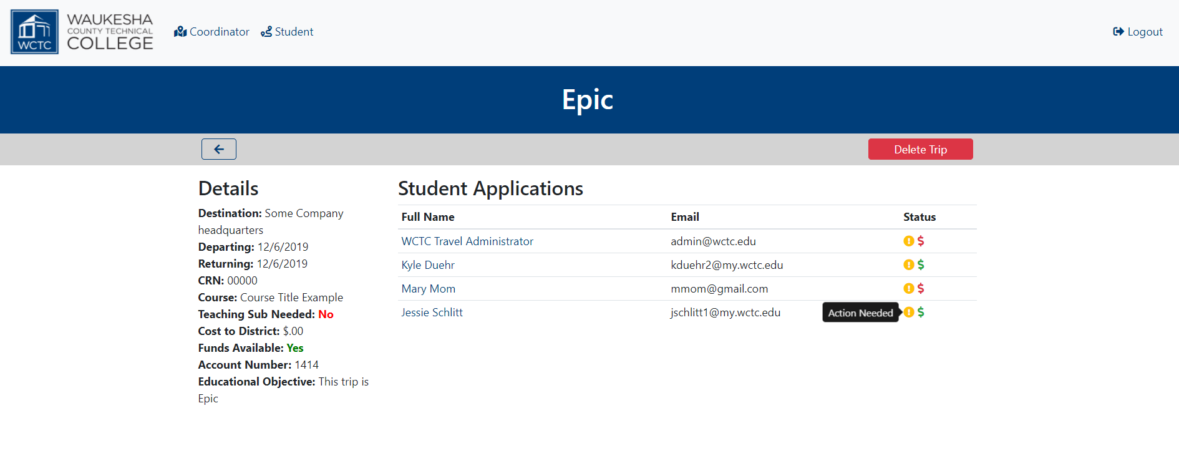
BEFORE
Coordinator Trip Detail Comparison
AFTER

Slide 11
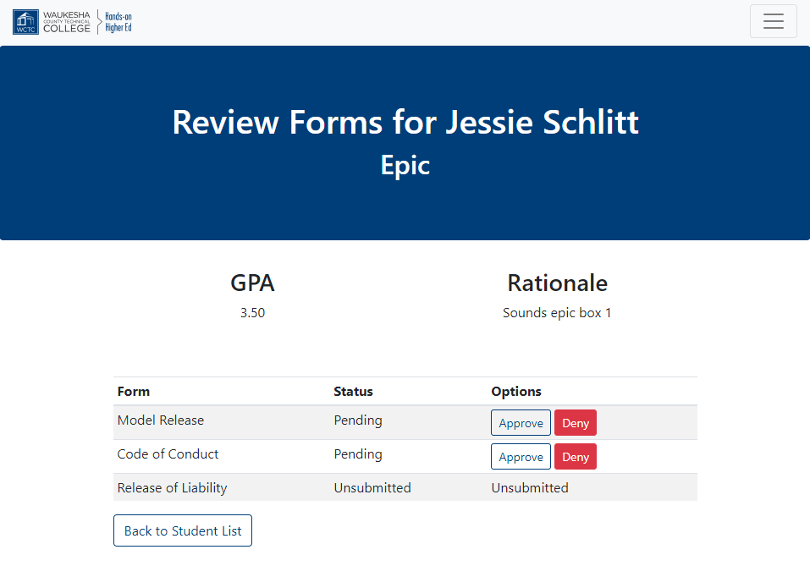
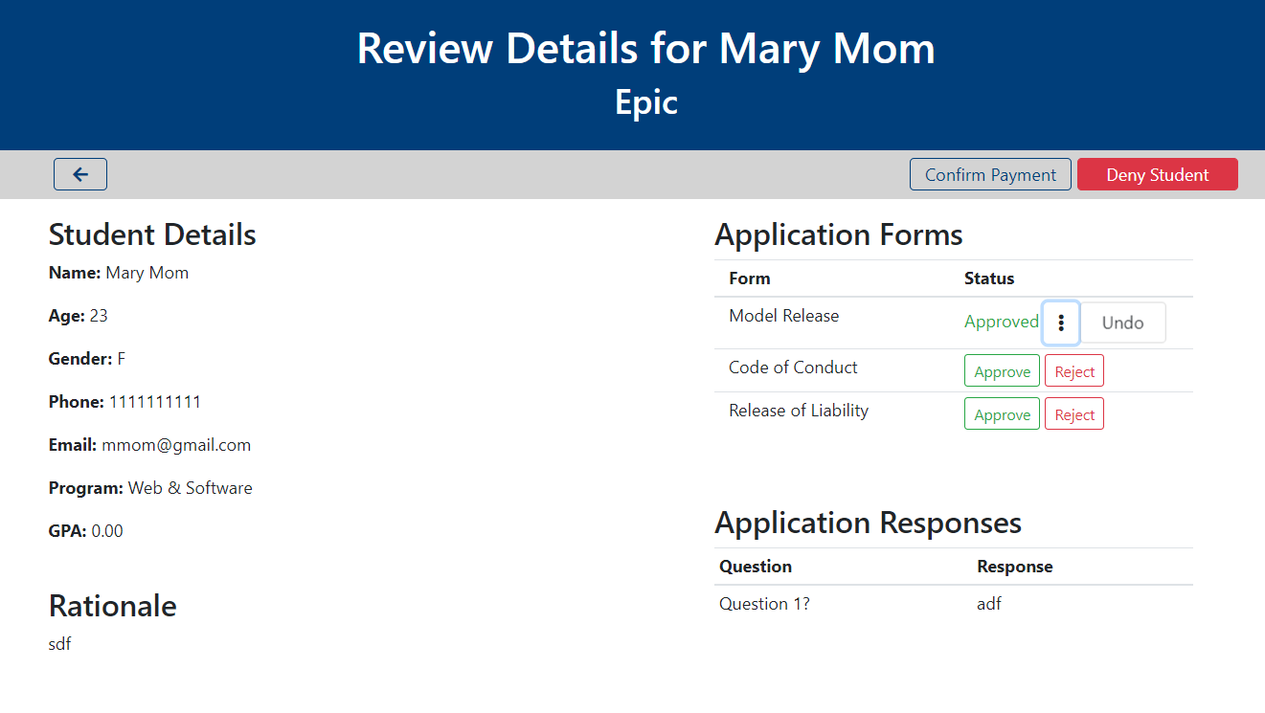
BEFORE
Application Detail Comparison
AFTER

Slide 12


Paper Trail
Notes:
Hailey
While we go through our demo in a minute, you will likely notice a paper trail in our project. What I mean is, there are no online signatures or form submissions because of legal reasons. The WCTC lawyers are skeptical about the online application process so we will show them it is possible to successfully use this system for all we need and at a later date, online form submission and payments will be added

Slide 13

Demo
Notes:
Nick will talk and Hailey will click away!
Sign in as a coordinator/
Create a trip(from recreate trip)/explain trip details a little (custom questions)
Create a student account/
Update profile
Sign up for a trip,(custom questions)
Submitted forms as a student
Approve as coordinator forms
Payment approval student/coordinator
Deny student/delete trip
Coordinator accepts trip???
Central coord forms view and print

Slide 14

Thank You
Notes:
Next Semester, initiate Q/A, and thanks for listening everyone!

Slide 15
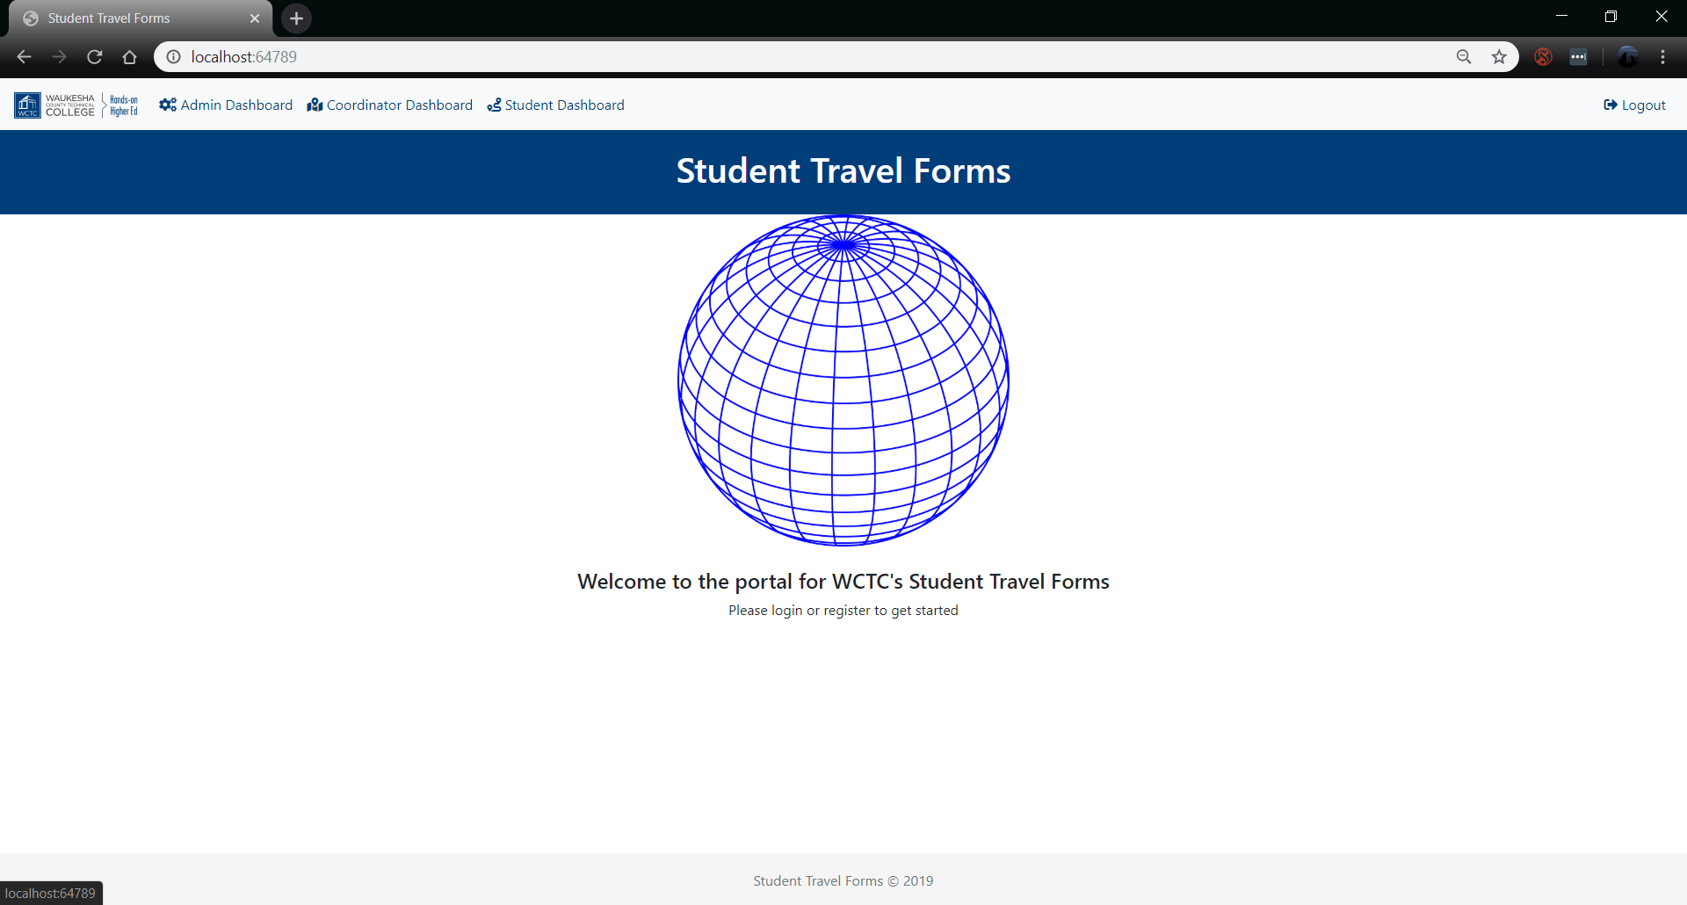
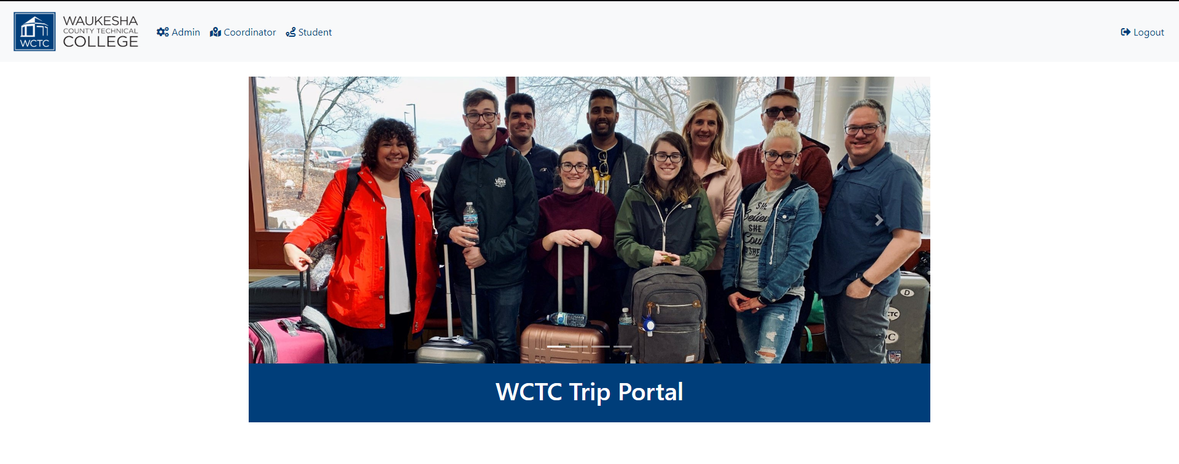
BEFORE
Welcome Comparison
AFTER
Notes:
Jessie
Make it more personal is in backlog
Hailey -Screenshots

